Slide 1

Systems Thinking
Cognitive Dissonance
It’s actually a super power
Use it as such

Slide 2
“The meat became so clever that it convinced itself it was no longer meat…”
~ Buddha, or something

Slide 3
Preface
Define Cognitive Dissonance
Multiple Disciplines and POVs
Unpack Implications
Analyze Aspects
New Understanding
How to approach this video

Slide 4

Cognitive Dissonance
The mental discomfort experienced when conscious of conflicting beliefs, values, or attitudes. A collision.
Mental Discomfort: A sense of unease or tension that prompts attention. Affective result.
Conflicting Beliefs: Collision between conflicting beliefs or ideas. Irreconcilable.
Motivational Drive: Pushes individuals to resolve inconsistencies, or reject source of dissonance. Akin to curiosity and hunger. Natural impulse, instinctive.
Adaptive Function: Evolved as a tool for improving mental models, getting at the truth.
Social Impact: Plays a role in discourse, cultural norms, and societal progress.

Slide 5

Evolution
The adaptive mental trait that evolved to signal inconsistencies between beliefs, actions, and reality for survival advantages.
Ancestral Origins: Not unique to humans; found in ancestral species. Magic tricks work on chimps.
Survival Advantage: Aids in better decision-making and prediction. Where food? What poison?
Error Detection: Drives individuals to adjust flawed perspectives. Identifying and resolving flaws.
Complex Knowledge: Predicated by the capacity for abstraction and representation.
Social Function: Enables collective dialogue in verbal species to work towards better understanding.

Slide 6
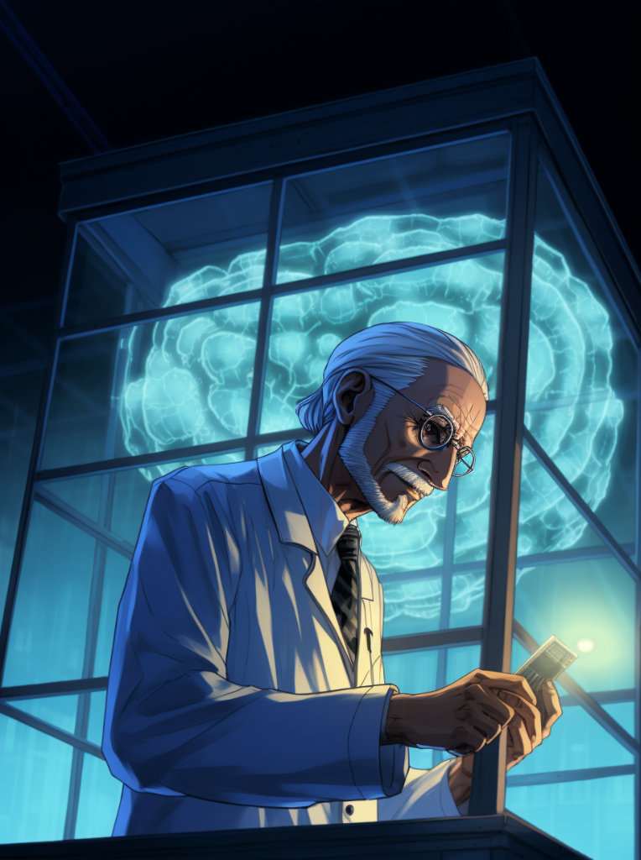
Neuroscience
The neural mechanisms that facilitate the detection of incongruent beliefs and prompt cognitive adjustments.
Multiple Beliefs: Neural capacity to hold and manage different beliefs simultaneously.
Comparison Machinery: Dedicated neural circuits for comparing and contrasting beliefs.
Reconciliation Limits: Neural recognition of beliefs that can and cannot be harmonized.
Latent to Conscious: Cognitive dissonance can transition from latent awareness to conscious focus.
Emotional Impetus: Emotional centers in the brain fuel the drive to resolve dissonance.

Slide 7

Philosophy
The epistemological implications of cognitive dissonance for assessing the reliability and limitations of human cognition.
Towards Objectivity: Capacity to hold abstract thoughts suggests some level of objectivity.
Biological Constraints: Our beliefs are subject to the limitations of our neural architecture.
Situated Awareness: Subjective experience is contextually embedded, limiting objectivity.
Metaphysical Mentalizing: Ability to conceptualize beyond immediate reality for richer perspectives.
Self-Correction: Cognitive dissonance acts as an internal mechanism for improving belief accuracy.

Slide 8

Computation
Exploring the possibility of formalizing cognitive dissonance through computational models, logic, and mathematics.
Symbolic Representation: Informational encoding of beliefs for computational analysis.
Formal Logic: Mechanistic tools for identifying and resolving cognitive dissonance.
Universal Computation: Relating to von Neumann and Turing machine concepts in handling dissonance.
Mathematical Foundations: Potential grounding of cognitive dissonance in mathematical principles.
Physics and Nature: Suggesting that logic and math, tools for handling dissonance, may be rooted in the fabric of the universe.

Slide 9

Society
The cumulative impact of cognitive dissonance resolution at a societal level, accelerated by technological advances and cultural shifts.
Collective Resolution: Society naturally resolves dissonance through shared conversations and experiences.
Historical Milestones: The Printing Press as a disruptive force that democratized knowledge.
Power Structures: Breakdown of traditional authority figures and systems, facilitating more egalitarian discourse.
Internet Culture: Accelerated rate of dissonance resolution and information sharing.
Globalism: Worldwide interconnectedness contributing to a quicker and broader reconciliation of societal dissonance.

Slide 10

Reactions
The various strategies people employ, either constructively or destructively, to alleviate cognitive dissonance.
Attack vs. Retreat: Two basic emotional valences in response to dissonance.
Internal vs. External: Dispositions indicating whether resolution strategies are inwardly or outwardly directed.
Reconciliation vs. Rejection: Two strategies to alleviate cognitive dissonance.
Emotional Rejection: External attack, such as unsubscribing from a channel that triggers dissonance.
Tribal Epistemics: External retreat, labeling conflicting information as "fake news" to dismiss it.
Analysis and Exploration: The healthiest approach, characterized as an internal retreat for deeper understanding.

Slide 11

Truth
Examining the notion that "truth" is not a universal constant but rather a state of cognitive equilibrium devoid of dissonance.
Sensation of Truth: Defined as the absence or alleviation of cognitive dissonance rather than universal fact.
Evolutionary Basis: Our belief in universal truth is shaped by common experiences throughout evolution.
Absence of Collision: Truth as merely the lack of conflict between beliefs and experiences.
Cognitive Tools: The mental mechanisms we possess for navigating toward truth and reconciliation.
Content and Knowledge: Adequate informational and mental resources are required for this navigation.

Slide 12

Potentiality
Exploring the mechanisms by which a state of cognitive equilibrium can shift to one of dissonance, either internally or externally induced.
Internal Reflection: Spontaneous dissonance through self-introspection and connecting dots.
External Vectors: Conflict triggered by external information such as news or conversations.
State Shift: Transitioning from a state of cognitive harmony to dissonance.
Dissonance Activation: How cognitive dissonance can suddenly shift and become active. Rude awakening!
Ever Present: It was always there, whether or not you were conscious of it. Bombs away!

Slide 13
Thank you

